Slide 1
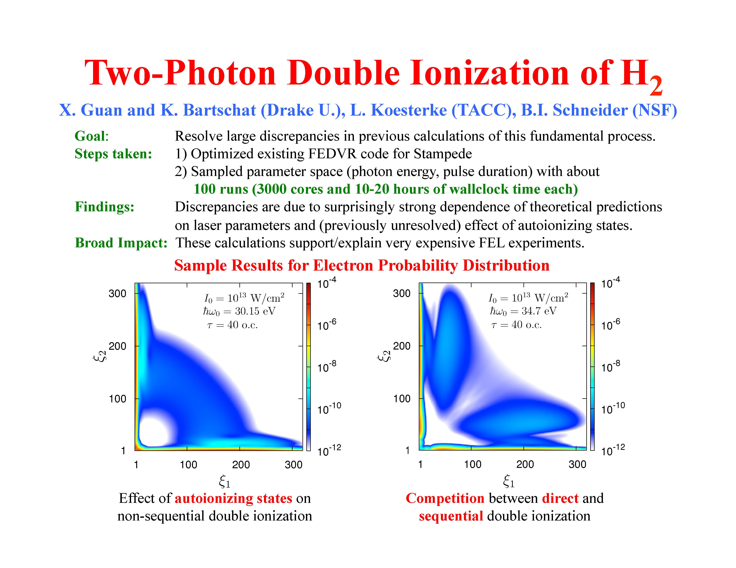
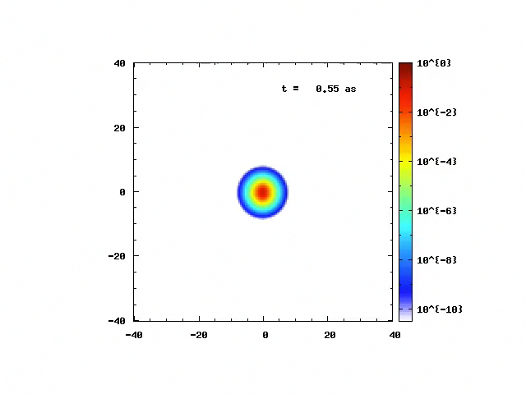
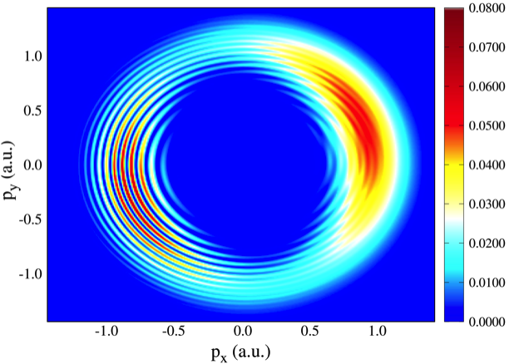
H⁺₂ Ionization in strong, ultrafast
electromagnetic field
Ionization of Ar(3d) by electron Impact:
Experiment(a) and Theory(b)
Photoelectron Momentum Distribution for Ar
Ionization in Strong Electromagnetic Field

